Slide 1
S
T
Log Out
Welcome to
Stutor
Student
Tutor
Account
ESE
Options >
Analysis I
Options >
Lineare Algebra I
Options >
New Tutor

Slide 2
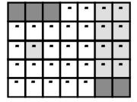
S
T
Log Out
Welcome to
Stutor
Student
Tutor
Account
Subject
< >
15-16
Add Disponibility
Lecture
University
Monday 14-16
Thhuesday 8-12
Saturday 8-18
Gender
V
Search

Slide 3
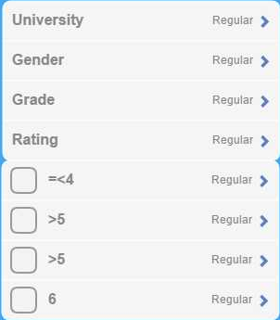
S
T
Log Out
Welcome to
Stutor
Student
Tutor
Account
Tutor 1 ♂
ESE UNIBE 5.5
Profile
6
Tutor 2 ♀
ESE UNIBE 6
Profile
5.7
Tutor 3 ♂
ESE UNIBE 5
Profile
5.4

Slide 4
S
T
Log Out
Welcome to
Stutor
Student
Tutor
Account
< >
Tutor 1
ESE 5.5
Jack ♂
Analysis I 5
6
> see comments
Lineare Algebra I 5.5
Description Place Holder Description Place Holder Description Place Holder Description Place Holder Description Place Holder Description Place HolderDescription Place Holder Description Place Holder Description Place Holder Description Place Holder Description Place Holder Description Place Holder Description Place Holder Description Place Holder Description Place Holder Description Place Holder Description Place Holder Description
Send Request

Slide 5
S
T
Log Out
Welcome to
Stutor
Student
Tutor
Account
< >
Requests
ESE yesterday >
Add Lecture

Slide 6
S
T
Log Out
Welcome to
Stutor
Student
Tutor
Account
Name, Surname, Username
change >
E-Mail
change >
Password
change >
Payment Options
change >
Delete Account
delete >

